Slide 1
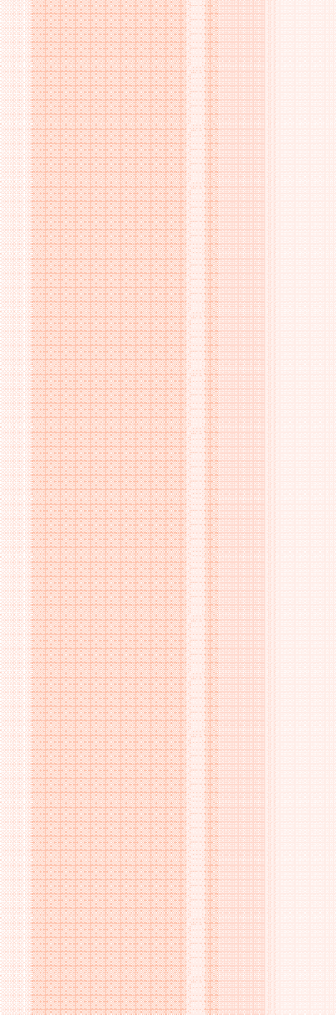

Testing & Commissioning
A Presentation
On Module-1: Transformer Testing

Slide 2
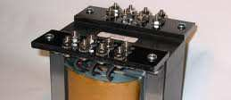
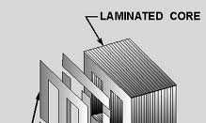


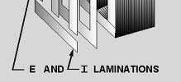

Losses of Transformers
The transformers are made of 2 types of materials: Iron and Copper. The core of a transformer is made of Iron whereas the winding which is wrapped over the iron core is made up of Copper.
= +
Transformer
Iron Core
Copper Winding
Correspondingly there are 2 types of losses: Iron Loss and Copper Loss. Iron and Copper losses are measured by open circuit and short circuit tests.

Slide 3
TESTS OF DISTRIBUTION TRANSFORMERS
Two tests are conducted for testing transformers. These tests are known by different names as described in the table below.
Short Circuit Test Open Circuit Test OR OR
Full Load Test No Load Test OR OR
Copper Loss Test Iron Loss Test OR OR
Winding Loss Test Core Loss Test

Slide 4
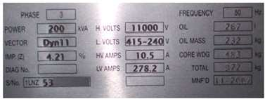
EXAMPLE OF A TRANSFORMER NAME PLATE

Slide 5
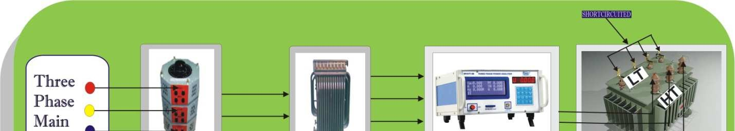
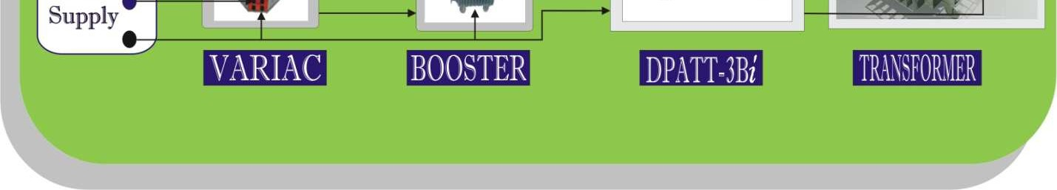
Short Circuit Test
The following picture shows the arrangement for conducting Short Circuit Test using DPATT-3Bi.
LT side short circuited
Voltage applied at HT side

Slide 6
O This test is conducted on the High Voltage side (HV Side) of the Transformer.
O The Secondary Winding (usually Low Voltage Side) of the Transformer is short circuited.
O Full load current is applied on the primary side of the transformer.
O The core losses are very small because applied voltage is only few percentages of nominal voltage and hence can be neglected.
O Therefore the wattmeter measures only full load copper loss.

Slide 7
Steps for conducting Short Circuit Test:
(1). Calculate Full Load Current from parameters available in Transformer’s name plate as described below.
Transformer Rating:
HT Voltage LT Voltage
= 11KV
= 415V (P-P)
KVA Rating = 200 KVA
Full Load Current = 10.49A

Slide 8
Short circuit LT side and apply voltage at HT side of transformer until the full load current is achieved.
(2).
(3). Now calculate Impedance Voltage (the voltage at which full load current is achieved) and then calculate
% Impedance as per the following formula.
% Impedance = (Impedance Voltage / Rated Voltage) * 100
Suppose the Full Load Current, 10.49A is obtained at 463.1V therefore the Impedance Voltage is 463.1V.
% Impedance = (Impedance Voltage / Rated Voltage) * 100
= (463.1 * 100) / 11000
= 4.21

Slide 9
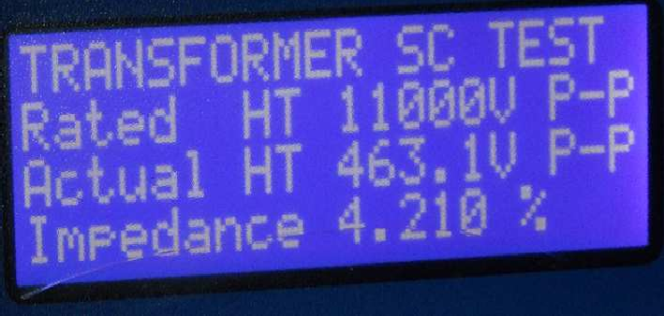
On Pressing F2 button of the keypad of DPATT-3Bi, the parameters of Short Circuit Test are displayed on the LCD Display as shown below.
Parameters of Short Circuit Test
This is a big advantage of DPATT-3Bi that it can be used for Transformer Testing.

Slide 10
(4). On pressing button ‘3’ of the keypad of DPATT-3Bi, W/PF page appears on the LCD Display showing Copper Losses.
The value of Full Load Current for Transformers of different ratings is shown in the following table.
Example: 11KV / 415V
Rating of Transformer | Full Load Current
200KVA | 10.48A
300KVA | 15.72A
400KVA | 20.96A
500KVA | 26.2A
600KVA | 31.44A

Slide 11
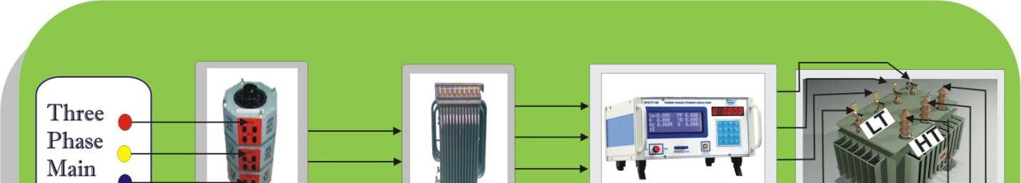
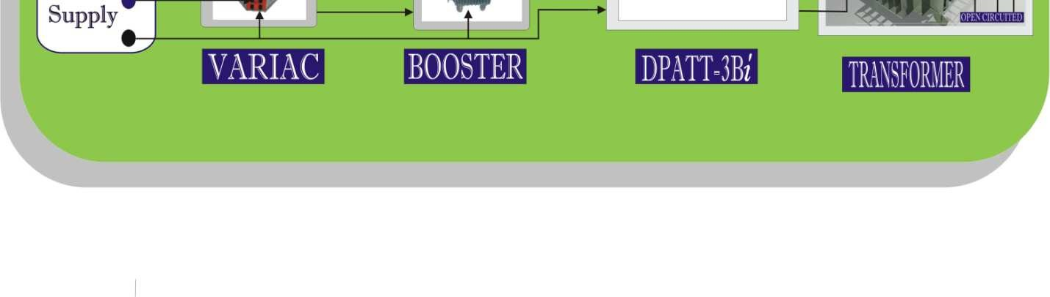
Open Circuit Test
The following picture shows the arrangement for conducting Open Circuit Test using DPATT-3Bi.
Voltage
applied at LT Side
HT Side is open circuited

Slide 12
Open circuit test is carried out to determine Iron Loss in Transformers.
Transformers dissipate Electrical Energy whenever they are On.
Core loss and magnetizing current depend upon applied voltage and frequency.
Since we have no control on variation of Mains Frequency therefore the applied voltage is varied to keep V/f ratio constant.
To minimize core loss, the design of Iron Core needs to be better.

Slide 13
Steps for conducting Open Circuit Test:
(1). Obtain the value of Rated Voltage from parameters given in transformer’s Name Plate as explained below.
Example: According to transformer’s name plate
HT Voltage LT Voltage KVA Rating
= 11KV
= 415V (P-P)
= 200 KVA
Rated Voltage = 11KV (Primary Side) Rated Voltage = 415V (Secondary Side)

Slide 14
(2). Open circuit HT Side while apply voltage at LT Side through variac until the Rated Voltage is achieved.
Note: Incase supply frequency is different from rated frequency, the voltage to be applied is calculated as per supply frequency.
Illustration:
Rated LT Voltage Rated Frequency
If, Supply frequency Voltage to be applied,
V_{RT} = 415 V F_{RT} = 50 Hz F_{S} =49.50Hz
V_{A} = (V_{RT} / F_{RT} ) * F_{S}
V_{A} = (415 / 50) * 49.50
= 410.85V

Slide 15
Calculate No Load Current as described below.
Illustration:
Transformer Rating
HT Voltage= 11KV , Rated Voltage = 415V
LT Voltage=415V , Full Load Current = 10.49A Rating of T/F= 200KVA
According to BEE
No Load Current = 2.5% of Full Load Current
= (10.49* 2.5 / 100)
No Load Current = 0.26A

Slide 16
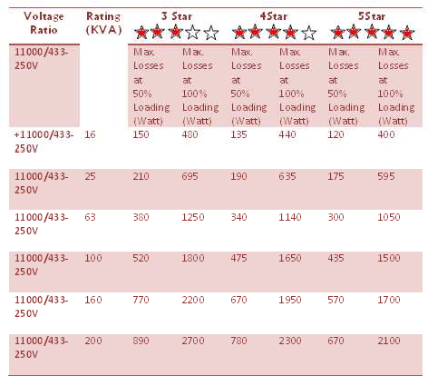
The maximum allowed loss at rated voltage and rated frequency permitted at 75˚C for 11/0.433 KV transformer can be chosen by utility from the value of 3 star, 4 star or 5 star ratings for transformers up to the rating of 200 KVA as indicated below:

Slide 17
The value of impedance of transformers at 75˚C shall be 4.5% for transformers up to 200 KVA and for ratings above 200 KVA, it shall be in accordance with IS 2026 (BEE).
Typical value of impedance voltage for transformer with two separate windings (At rated current, given as a percentage of the rated voltage of the winding at which the voltage is being applied) I S 2026.
Rated Power (KVA) | Impedance Voltage (Percent)
Up to 630 | 4.0
631 to 1250 | 5.0
1251 to 3150 | 6.25
3151 to 6300 | 7.15
6301 to 12500 | 8.35
12501 to 25000 | 10.0
25001 to 200000 | 12.5

Slide 18
References:
(1).
(2).
(3).
I S 2026-1977-Specification for Power Transformer. BEE CODE Transformer-2006
Electrical Machines (J.B. Gupta)

