Slide 1


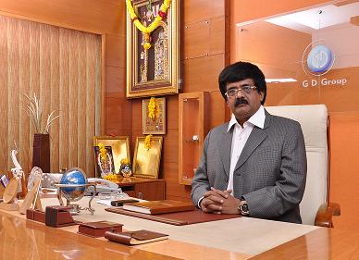
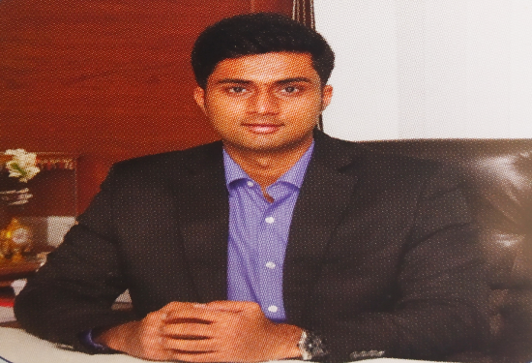
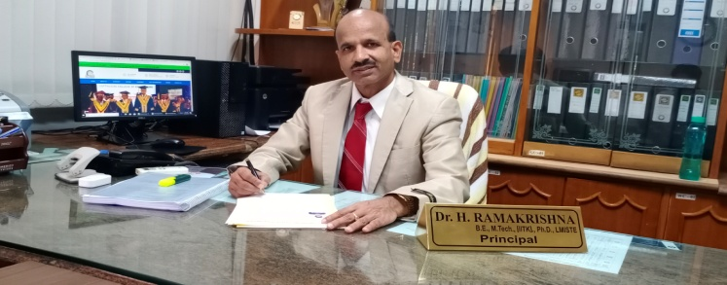
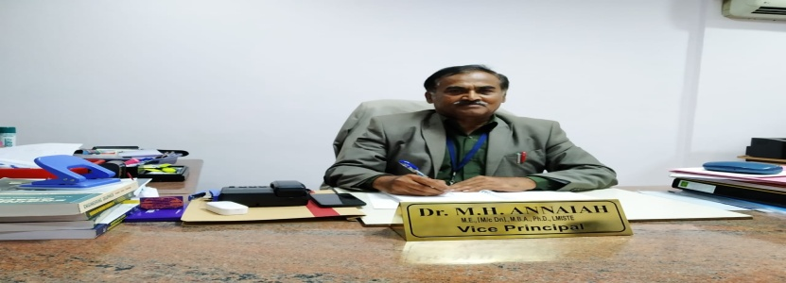
Sapthagiri College of Engineering
Department of Physics
Physics Magazine
Where learning never ends…
News Letter for the AY : 2018-2019
VISION
MISSION
To provide a sound basic education in physics for students planning carrier in engineering.
To feed the budding engineer with finer aspects of science which make him understand, exploit and innovate, thus contributing to the technological advancement of tomorrow.
To offer high quality education in engineering physics with practical and provides strong foundation for all branches of engineering and technology.
Chairman’s Message
The “PHYSICS MAGAZINE” newsletter of the department PHYSICS is providing great space for the faculty and students to pen down their innovative ideas, imagination and perceptions to show case their creativity. So, I take the opportunity to congratulate the department of ISE and its editorial team to successful release of this issue. I am sure that students and faculty will find the content of this edition very interesting and educating.
Chairman: Sri G. Dayanand
Executive Director’s Message
I am indeed happy to know that the department of PHYSICS taken initiative in realizing its monthly newsletter “PHYSICS MAGAZINE” and urge faculties and students to make use of the platform to share and educate among themselves in publishing article pertaining to the emerging domain and articles of interesting. I congratulate the team of editorial community and department of PHYSICS
Executive Director: Sri G. D Manoj
Principal’s Message
It gives me immense pleasure to note that, SCE has been publishing bi-annual newsletter and I am sure, this will provide an opportunity for the faculty and students to share their knowledge and beacon the information about various issues and activities that are being taking place in the department. I look forward for more activities and achievements for the department to march towards excellence in the future. I would like to thank all teaching, supporting staff and our beloved students for their active participation in publishing this magazine. My special compliments and congratulation to the editorial team of the department for their consistent effort in publishing this newsletter.
Dr. H Ramakrishna Principal
Vice- Principal’s Message
I am very happy and delighted to know that our college is bringing out the college newsletter. SCE is one of the leading premier engineering colleges in the country offering quality technical education to students thereby enabling them to become globally acceptable engineers in their domains. The newsletter provides a platform for both faculty and students to showcase their achievements and hidden talents. I congratulate our beloved principal and members of editorial board for bringing out this excellent and informative newsletter on time.
Dr M H Annaiah Vice-Principal

Slide 2
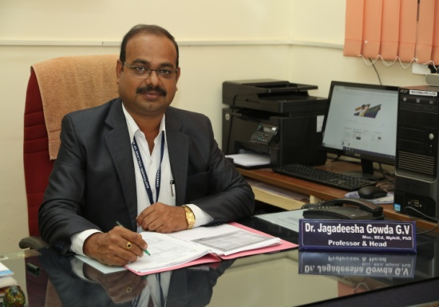
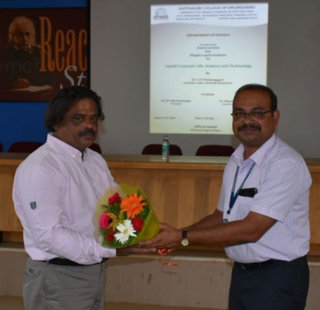
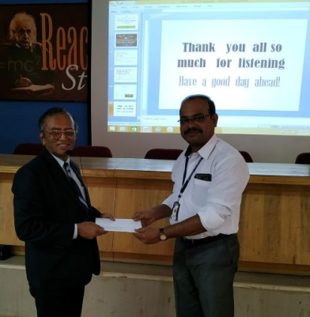
HOD’S DESK
The Department of Physics has come into existence since the inception of the Institute. The department is involved in teaching the Engineering Physics Theory and Laboratory courses to the students of different Engineering disciplines. The department has six active faculty members and engaged in research and teaching at the frontier areas of experimental physics. Our exceptional research profile directly feeds into our teaching experience. This ensures good academic performance of the students. The Department has been getting excellent results both in theory and practical examinations.
Dr.Jagadeesha Gowda.G.V
Professor & HOD
Events Conducted in the Department
Guest Lecture - 1
 | Physics department has organized the guest Lecture for Physics cycle students on the topic “Liquid crystals: Life, Science and Technology” on 27/04/2019 at 11: 00 am by the guest Dr. C V Yelamaggad, Scientist, CeNS, Bangalore. The Program was conducted and Co-ordinated by Dr. Jagadeesha Gowda, HOD, dept of Physics. The session was Inaugurated by Dr. K L Shivabasappa, Principal, & Dr. Nagabhushana K R, Administrative officer.
Guest Lecture - 2
 | Department of Physics has conducted the guest Lecture for Physics cycle students studying in 2nd semester on the topic “Early History of Quantum Mechanics” on 30/05/2019 at 10: 30 am by the guest Dr. S P Basavaraju, Former HOD, Department of Physics, BIT, Bengaluru. The Program was conducted and Co-ordinated by Dr. Jagadeesha Gowda, HOD, dept of Physics. The session was Inaugurated by Dr. K L Shivabasappa, Principal, & Dr. Nagabhushana K R, Administrative officer.

Slide 3
Publications
Jagadeesha Gowda G V, Devaraja C and B Eraiah, “Influence of europium (Eu³⁺) ions on the optical properties of boro tellurite glasses,” AIP proceedings, 2018, Vol.1953, Page No. 030009 (1-4). DOI: 10.1063/1.5032344
K. Keshavamurthy and B. Eraiah, “Effect of γ-ray Irradiation on Optical Properties of Erbium doped Bismuth-Tellurite Glasses,” AIP proceeding ,2018, Vol.1953, Page No. 090004 (1-4). DOI: 10.1063/1.5032851
Devaraja C, Jagadeesha Gowda G V, Eraiah B and Keshavamurthy K, “FTIR and Raman Studies of Eu³⁺ Ions Doped Alkali Boro Tellurite Glasses,” AIP proceeding, 2018, Vol.2115, Page No. 030230(1-4).
B. S. Shashikala, H B Prem Kumar, “Rational design of bi-functional RE³⁺ (RE = Tb, Ce) and alkali metals (M⁺ = Li, Na, K) co-doped CaAl₂O₄ nanophosphors for solid state lighting and advanced forensic applications,” Materials Research Bulletin 115 (2019) 88–97.
Papers Presented in Conference/Symposium/Workshop Attended
Dr. Jagadeesha Gowda G V, Shashikala B S, Gnanendra D S, Devaraja C and Dr. Keshavamurthy K, have attended Faculty Development Program (FDP) on “Teacher Empowerment”, held at Sapthagiri College of Engineering, Bangalore. July 23-25, 2018.
Jagadeesha Gowda.G.V, Devaraja.C, B.Eraiah have presented a paper, “FTIR and Raman Studies of Eu³⁺ Ions Doped Alkali Boro Tellurite Glasses”. At 63rd DAE Solid State Physics Symposium, Guru Jambheshwar University of science & technology, Hisar, Haryana India. Dec 18-22, 2018.
B. S. Shashikala, H B Prem Kumar have presented a paper, “Spectroscopic Studies of Strong Red Emitting CaAl₂O₄:Eu³⁺ Nano Phosphor WLED’s Applications Using Judd-Ofelt theory”, at International Conference On Luminescence and Its Applications, Pt. Ravishankar Shukla University, Raipur. January 7-10, 2019.
Jagadeesha Gowda.G.V, Devaraja.C, have presented a paper, “Structural and optical investigations on Europium oxide doped alkali boro tellurite glasses”, at Advanced Functional Materials for Energy, Environment and Health Care (AFMEEHC), Mysore University, Mysore, Karnataka, India. March 18-20, 2019.
Jagadeesha Gowda.G.V, Keshavamurthy K, have presented a paper, “Thermal and StructuralProperties of Alkali-Vanado-Bismuth-Tellurite glasses”, at International Conference on Advanced Materials (ICAM-2019), Nirmalagiri College, Kannur, Kerala, India. June 12-14, 2019.
Gnanendra D S, has attended Two days faculty development program on Material Science and Technology during 22nd to 23rd April 2019 held at RRIT, Bangalore.

Slide 4
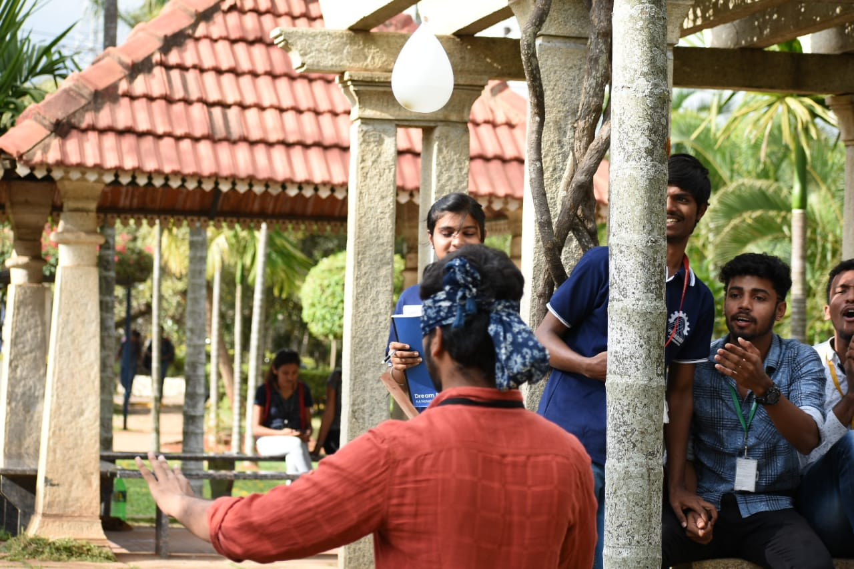
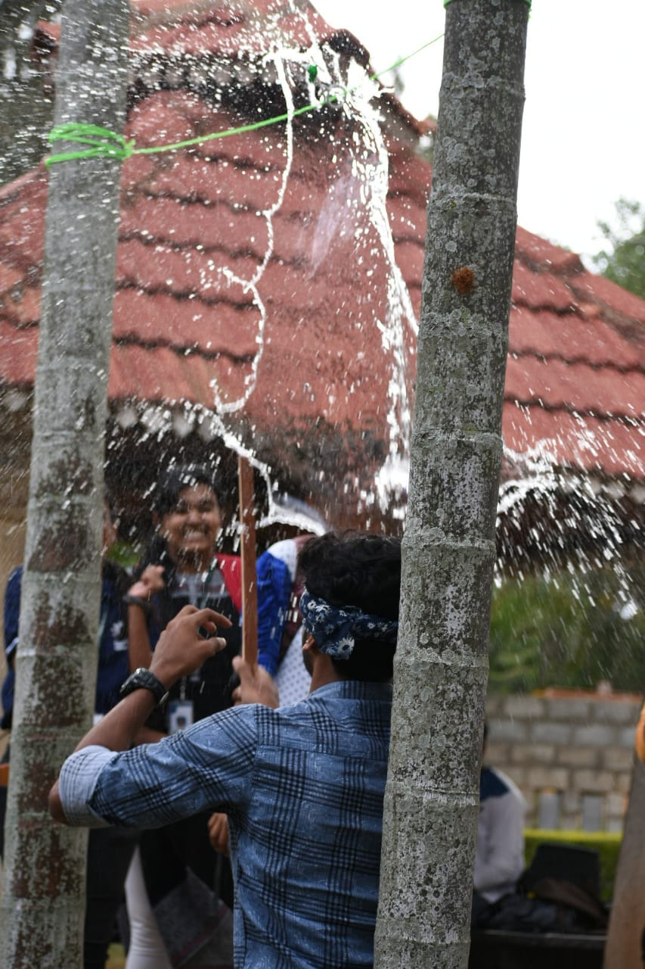
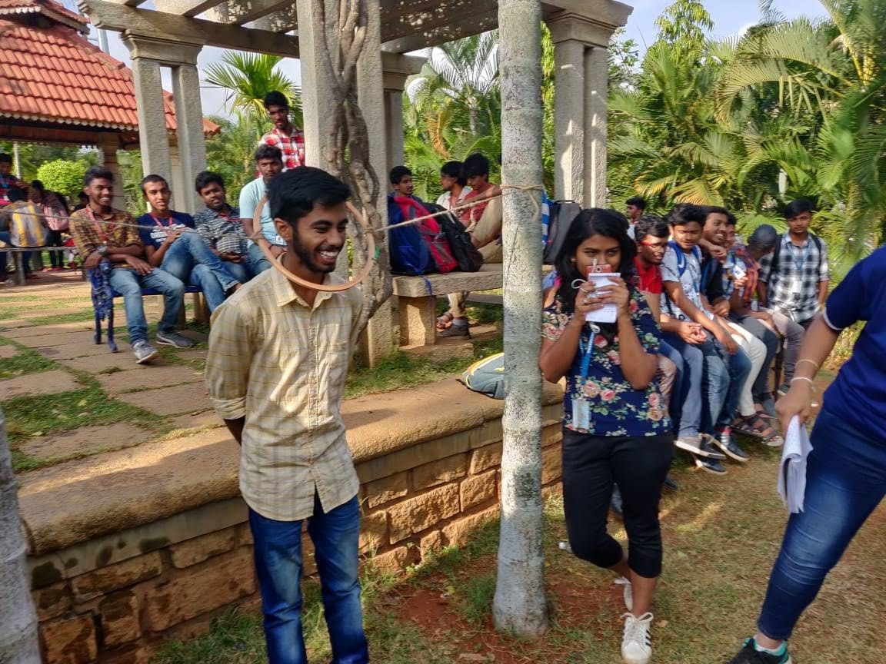
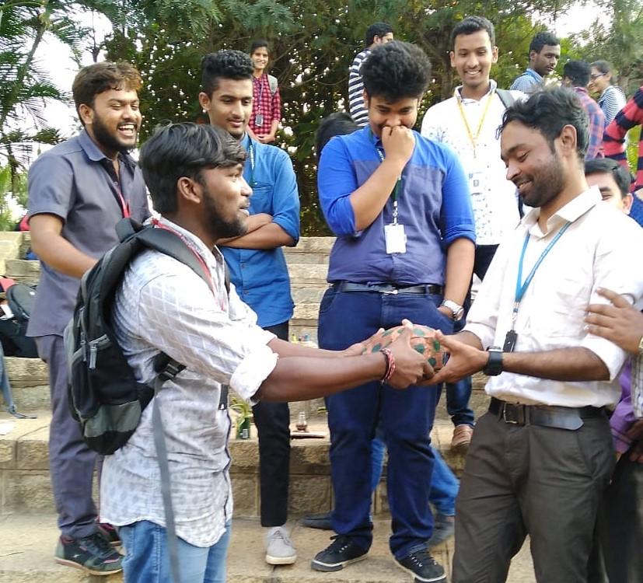
Kannada kalarava event Conducted By STEC team on 14th April 2019
Ice Breakers event Conducted By STEC team on 14th April 2019
Editorial board: Chief Co-ordinator: Dr. Jagadeesha Gowda, HOD, Dept of Physics Dept Co-ordinator : Mr. Gnanendra D S, Asst Professor, Dept of Physics Faculty Co-ordinator : Dr. Keshavamurthy K, Asst Professor, Dept of Physics

